Slide 1
This is a hidden slide
Dear honorable teacher please follow the instructions that has given in the slide notes (under the every slide). It would be helpful to take a successful class. Thanks a lot. I wish you good luck.

Slide 2

WELCOME
HOW ARE YOU ?

Slide 3


IDENTITY
SK.MD. HARUNAR RASHID.
Senior Teacher
Sonatola Model High School
Sonatola, Bogra.
Lesson
ENGLISH GRAMMAR.
Class : Nine & Ten
Unit : Four, Lesson : 2.

Slide 4
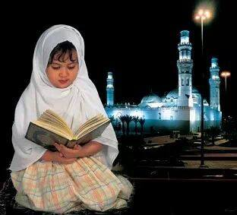

Reading the Quran is a good habit.
Walking is good for health.
Here reading is formed from the word read by adding ing and used as the subject of a verb and wroks of a noun.
Do you know, here reading (read + ing) what kinds of verb or parts of speech ?
It’s called a Gerund.

Slide 5
Lesson Declaration
So today we shall discuss about
Gerund

Slide 6
LESSON OUTCONES
By the end of the lesson students will have
learnt what Gerund is.
Learnt the difference between Participle and Gerund.
Learnt the uses of Gerund & Infinitive instead.
Used appropriate gerundial form of verbs.

Slide 7

Definition of Gerund
A Gerund is that form of the verb which ends in –ing, and has the force of a Noun and a Verb.
The Gerund has the force of a Noun and a Verb: it is a Verbal Noun.
Functions of Gerund :
a) As the subject of a verb :
Reading is our favourite pastime.
Learning is a continuous process.

Slide 8

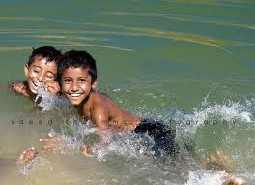
Functions of Gerund :
b) As the object of a verb :
Stop writing.
He learns drawing.
c) As the object of preposition:
They are fond of swimming
I am thinking of going there.

Slide 9

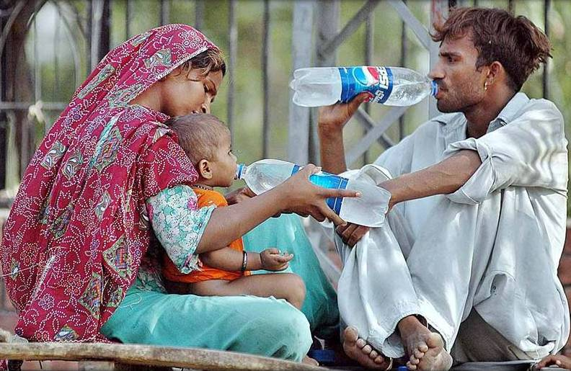
Functions of Gerund :
d) As a complement to verb :
Seeing is believing.
My hobby is reading.
e) As a part of compound noun :
We need safe drinking water.
The police used laughing-gas.

Slide 10
Individual Work
Open your English Grammar book page no. 26
Read the passage carefully :
Ask and answer with your partner :
How many verbs with+ ing are there in the passage ? Find out them.
Do all the verbs having ‘ing’ work as gerunds or participles ? If not identify and show them separately.
Are there infinitives in the passage ? Find out them.

Slide 11
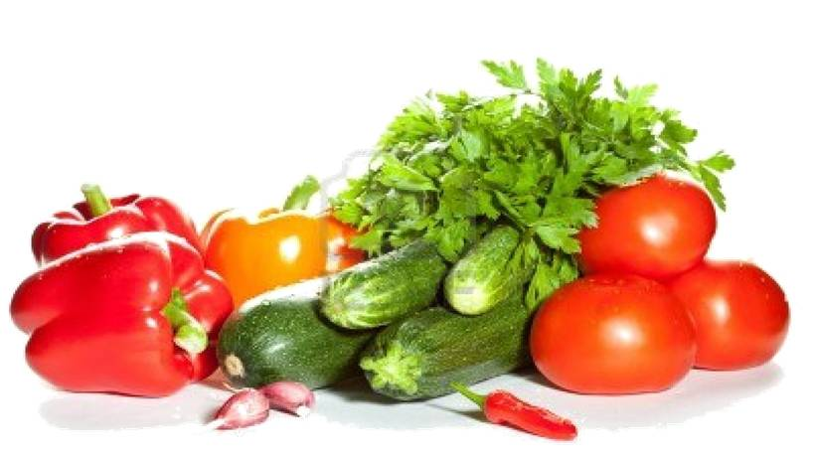
Pair Works
Replace infinitives of the following sentences by gerund.
i,. To tell a lie is a great sin.
I like to eat vegetables.
His hobby is to travel.
To walk is good for health.
He started to learn English.
It is bad to find fault with others.
To plant a sapling is everybody’s responsibility.

Slide 12
Group Works
Complete the following sentences by using appropriate gerundial form of verbs :
You cannot learn English without (a)……….... the four language skills. (b) ……….. is the first skill you should practise. The second one is (c) ………. . The third one is (d) ……….. while the fourth skill is (e) ……….. Unless you practise the skills, you cannot succeed in (f) ……….. any foreign language.
Answer : (a) practising, (b) listening, (c) speaking, (d) reading, (e) writing, (f) learning,

Slide 13

HOME WORK
Write the functions of Gerund :

Slide 14
Acknowledgement
We would like to express our cordial gratitude to the Ministry of Education, Directorate of Secondary & Higher Education, NCTB, a2i
and
the panel of honorable editors ( Md. Jahangir Hasan, Associate Professor (English) TTC, Rangpur, Ranjit Poddar, Associate Professor (English) TTC, Dhaka, and Urmila Ahmed, Associate Professor (English) TTC, Dhaka, to enrich the contents.

Slide 15

THE END.

